Slide 1


REAL ESTATE MANAGEMENT SYSTEM
- Pagadala Prasad

Slide 2

CONTENTS
01 | INTRODUCTION
02 | DESIGN
03 | UML
04 | CLASS & SEQUENCE
05 | MODULES
06 | TESTING
07 | CODE & OUTPUT
08 | INTERFACE
09 | CONCLUSION
10 | FUTURE SCOPE

Slide 3

INTRODUCTION
Real estate is considered real property that includes land and anything permanently attached to it or built on it weather natural or manmade. A type of real property with tangible assets. This includes land, buildings on the land, and improvements to the land, such as a roadway or private well. You might want to invest in real estate because of its potential for an excellent return. It’s a much less volatile investment than the stock market. And it has real value. Real estate always has value, unlike stocks which can sink to pennies on the dollar. It covers residential housing, commercial offices, and trading spaces such as theatre, hotels, and restaurant retail outlets, industrial buildings such as factories and government buildings.

Slide 4
EXISTING SYSTEM
The existing system of real estate involves the buying, selling, and renting of properties such as land, buildings, and homes. It typically operates through a network of real estate agents, brokers, and agencies who facilitate transactions between buyers and sellers.
DISADVANTAGES:
High Cost
The biggest disadvantage with real estate investment is the high capital requirement.
Long Term Investment
Real estate investments are always made as a part of a long-term strategy.
Legal Difficulties
Investing in real estate is tedious as it involves a lot of paperwork as well as cumbersome formalities, more so in the case of commercial real estate.
Liquidity Constraints
Real estate property is very illiquid. A huge amount of money gets locked up as it is difficult to readily find buyers and sellers.

Slide 5
PROPOSED SYSTEM :-
Real Estate Management System (REMS) is an online real estate software application that manages the overall operational activities and processes, starting from the management of the property, to the management of real estate agencies, agents, clients and financial transactions
ADVANTAGES:
Finances Are Easier to Monitor
With Easy estate real estate management software, you will be able to better monitor finances and they will be organized.
Property Management Is Efficient
The correct software provides you with better and efficient tools to accomplish the job so that you can convince both the tenants and the buyers with agreeable deals.
Save Valuable Time
Property management sofware is designed to save you time with features like sending automated notifications, such as when rent is due and balances.

Slide 6
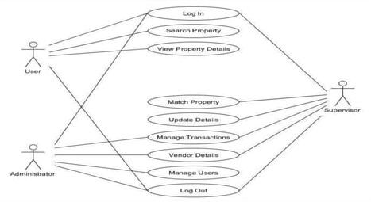
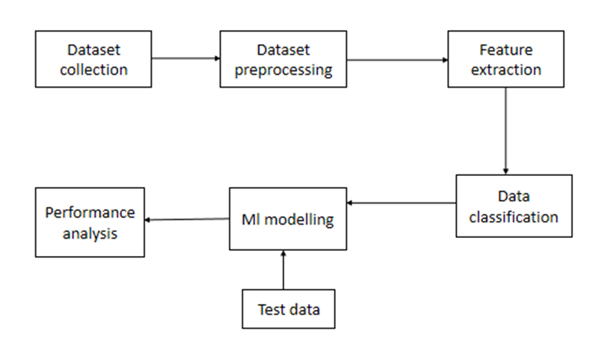
SYSTEM DESIGN

Slide 7
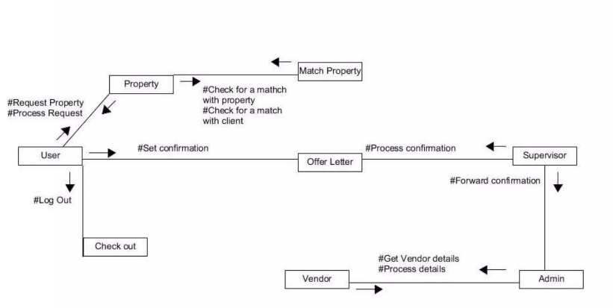
USE CASE DIAGRAM:-

Slide 8
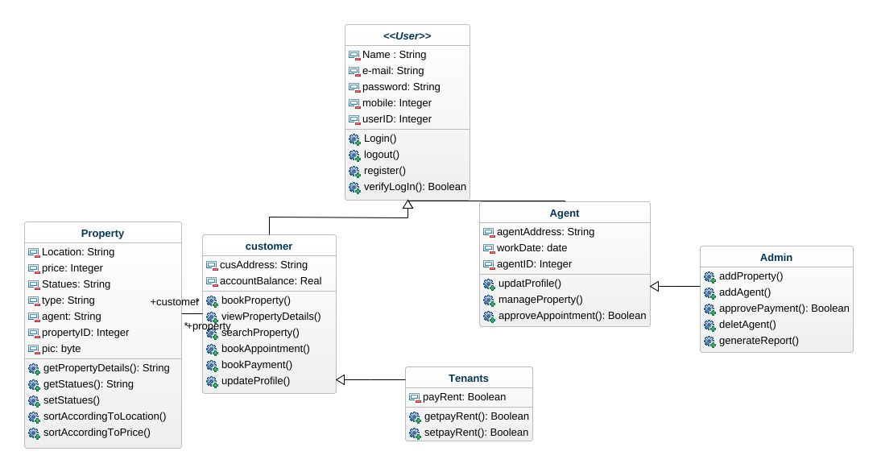
CLASS DIAGRAM :-

Slide 9

MODULES
We propose a Web application that manages the overall operational activities and processes, starting from the management of the property, to the management of real estate agencies, agents, clients and financial transactions.
1
2
3
4
RESIDENTIAL
REAL ESTATE
COMMERCIAL
REAL ESTATE
INDUSTRIAL
REAL ESTATE
LAND
DEVELOPMENT

Slide 10

MAP VISUALIZATIONS :-
Charts showing values that relate to geographical areas. Some examples include: (a) population density in each state of the United States, (b) income per capita for each country in Europe, (c) life expectancy in each country of the world. The tasks in this project include:
Sourcing freely redistributable vector outlines for the countries of the world, states/provinces in particular countries (USA in particular, but also other areas);
TIME SERIES TIME INTERACTIVITY :-
Implement a new (to JFreeChart) feature for interactive time series charts --- to display a separate control that shows a small version of ALL the time series data, with a sliding "view" rectangle that allows you to select the subset of the time series data to display in the main chart.

Slide 11
DASHBOARDS :-
There is currently a lot of interest in dashboard displays. Create a flexible dashboard mechanism that supports a subset of JFreeChart chart types (dials, pies, thermometers, bars, and lines/time series) that can be delivered easily via both Java Web Start and an applet.
PROPERTY EDITORS :-
The property editor mechanism in JFreeChart only handles a small subset of the properties that can be set for charts. Extend (or reimplement) this mechanism to provide greater end-user control over the appearance of the charts.

Slide 12
TESTING
1.Functional Testing
Functional tests provide systematic demonstrations that functions tested are available as specified by the business and technical requirements, system documentation, and user manuals.
Functional testing is centered on the following items:
Functions: Identified functions must be exercised.
Output: Identified classes of software outputs must be exercised.
Systems/Procedures: system should work properly
2.Integration Testing
Software integration testing is the incremental integration testing of two or more integrated software components on a single platform to produce failures caused by interface defects.

Slide 13
CODE AND OUTPUT

Slide 14

APPLICATON INTERFACE :-

Slide 15
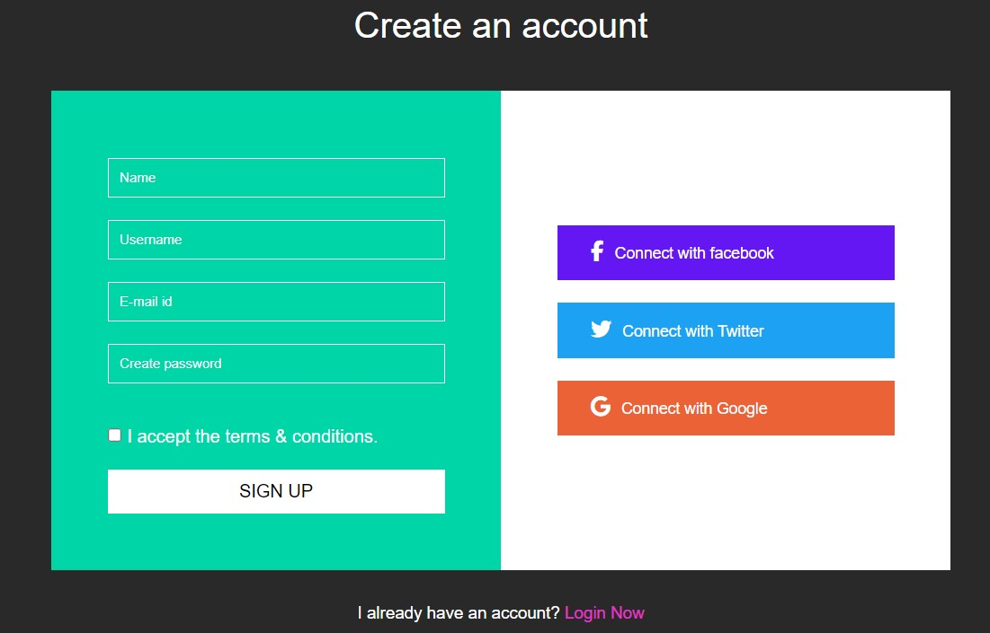
SIGN UP PAGE :-

Slide 16
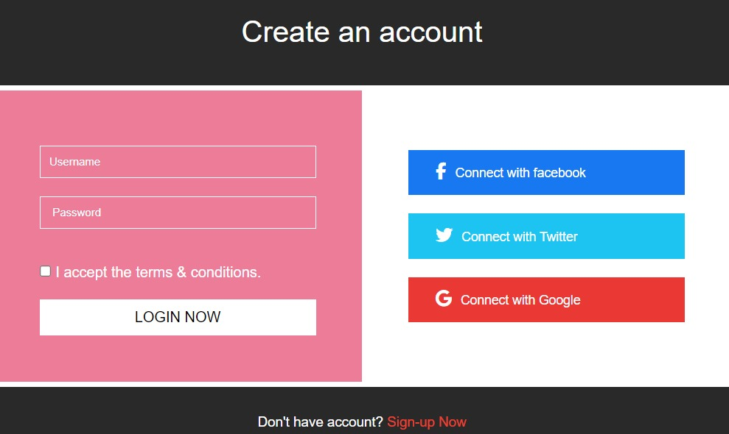
LOGIN PAGE :-

Slide 17

CODE AND OUTPUT

Slide 18
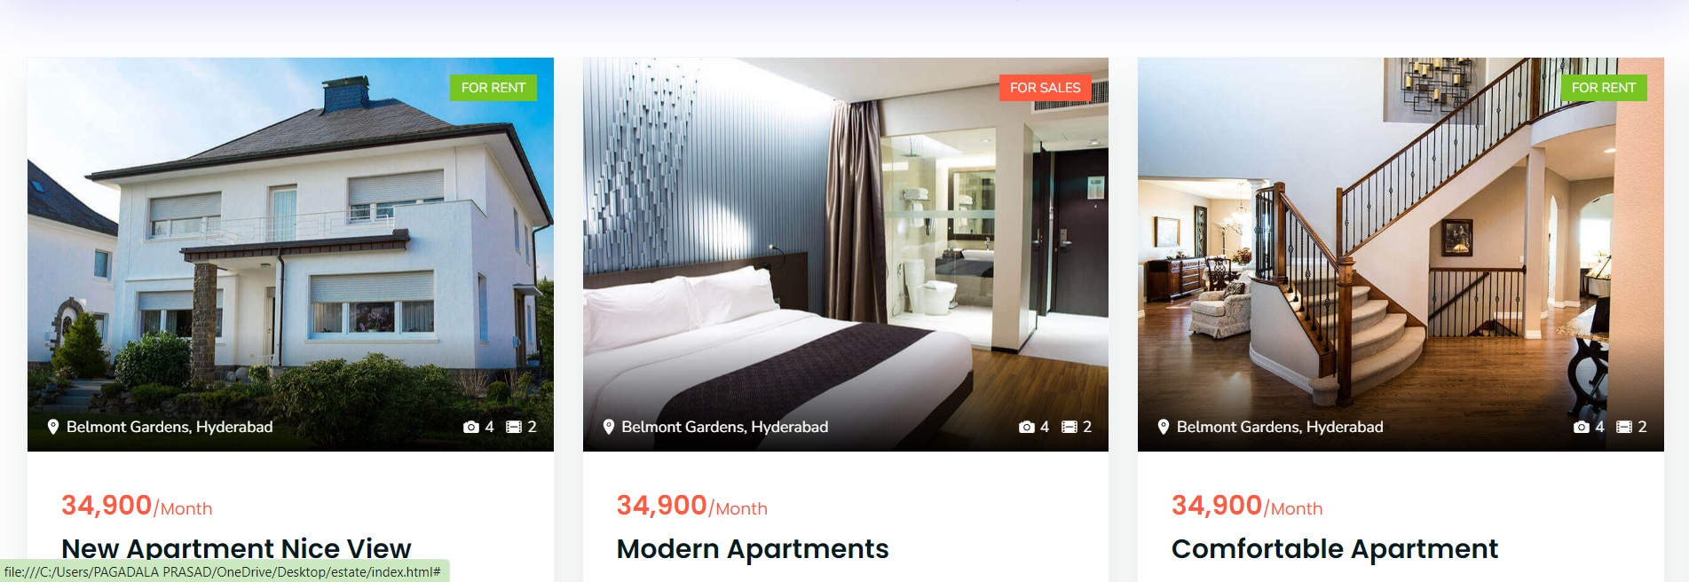

Slide 19
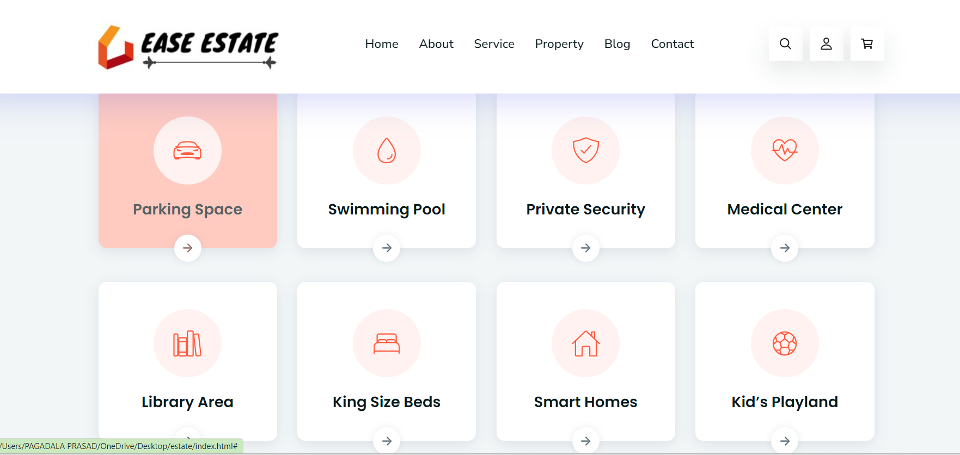
CODE AND OUTPUT

Slide 20
CONCLUSION
In conclusion, the real estate industry is a dynamic and multifaceted sector that plays a crucial role in the economic development of nations. Through its impact on job creation, infrastructure development, and overall economic growth, real estate proves to be a significant driver of prosperity
The Indian real estate market is currently experiencing a period of growth, with housing prices rising in several cities across the country.
The Commercial Real Estate Investment Market is a complex system of firms based in different sectors of the industry. The future of companies in this sector are most directly affected and tied to changes in global economic conditions.

Slide 21
FUTURE SCOPE
The real estate market in India has been experiencing dynamic shifts and changes over the years, driven by technological advancements, demographic shifts, and economic fluctuations after the pandemic.
In 2023, home buyers need to be aware of estate industry in India. The Market research analysts at concorde have gathered industry trends and real estate predictions for the next five years.
India's real estate market is expected to undertake a growth rate (CAGR) of 9.2% during the five years from 2023 to 2028. Looking ahead, the future of the real estate market in India appears promising, with continued growth and evolution.

Slide 22
THANK YOU

